Slide 1
Jessica Abernathy
happiness
growth
balance
productivity
fairness
family
Work ethnic
challenge

Slide 2
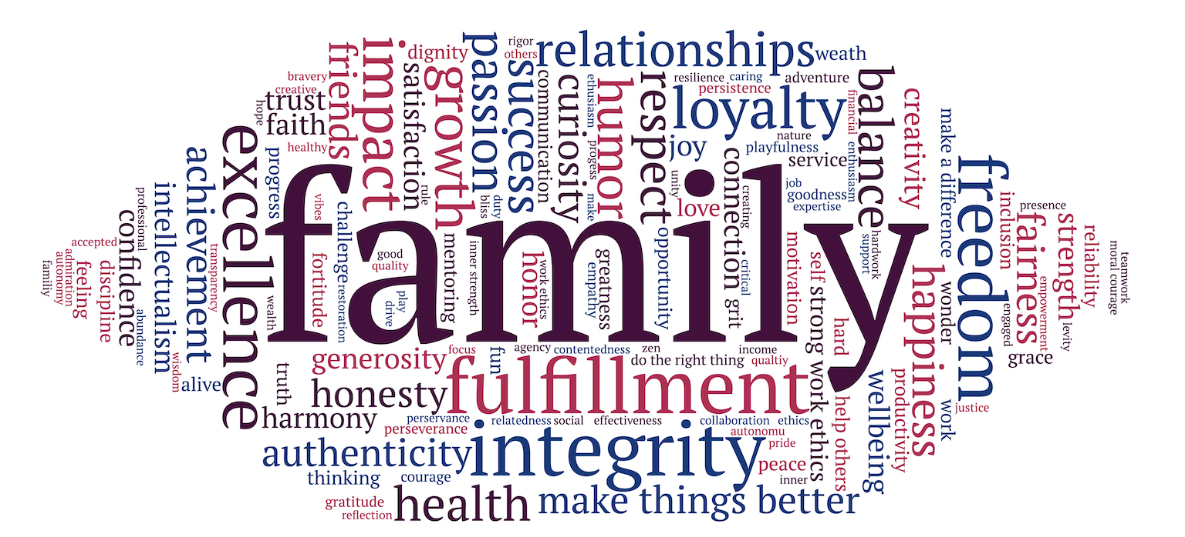

Slide 3
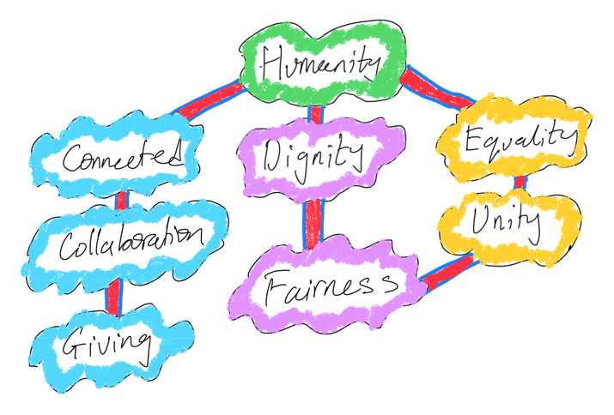
Omokhoje Amu

Slide 5
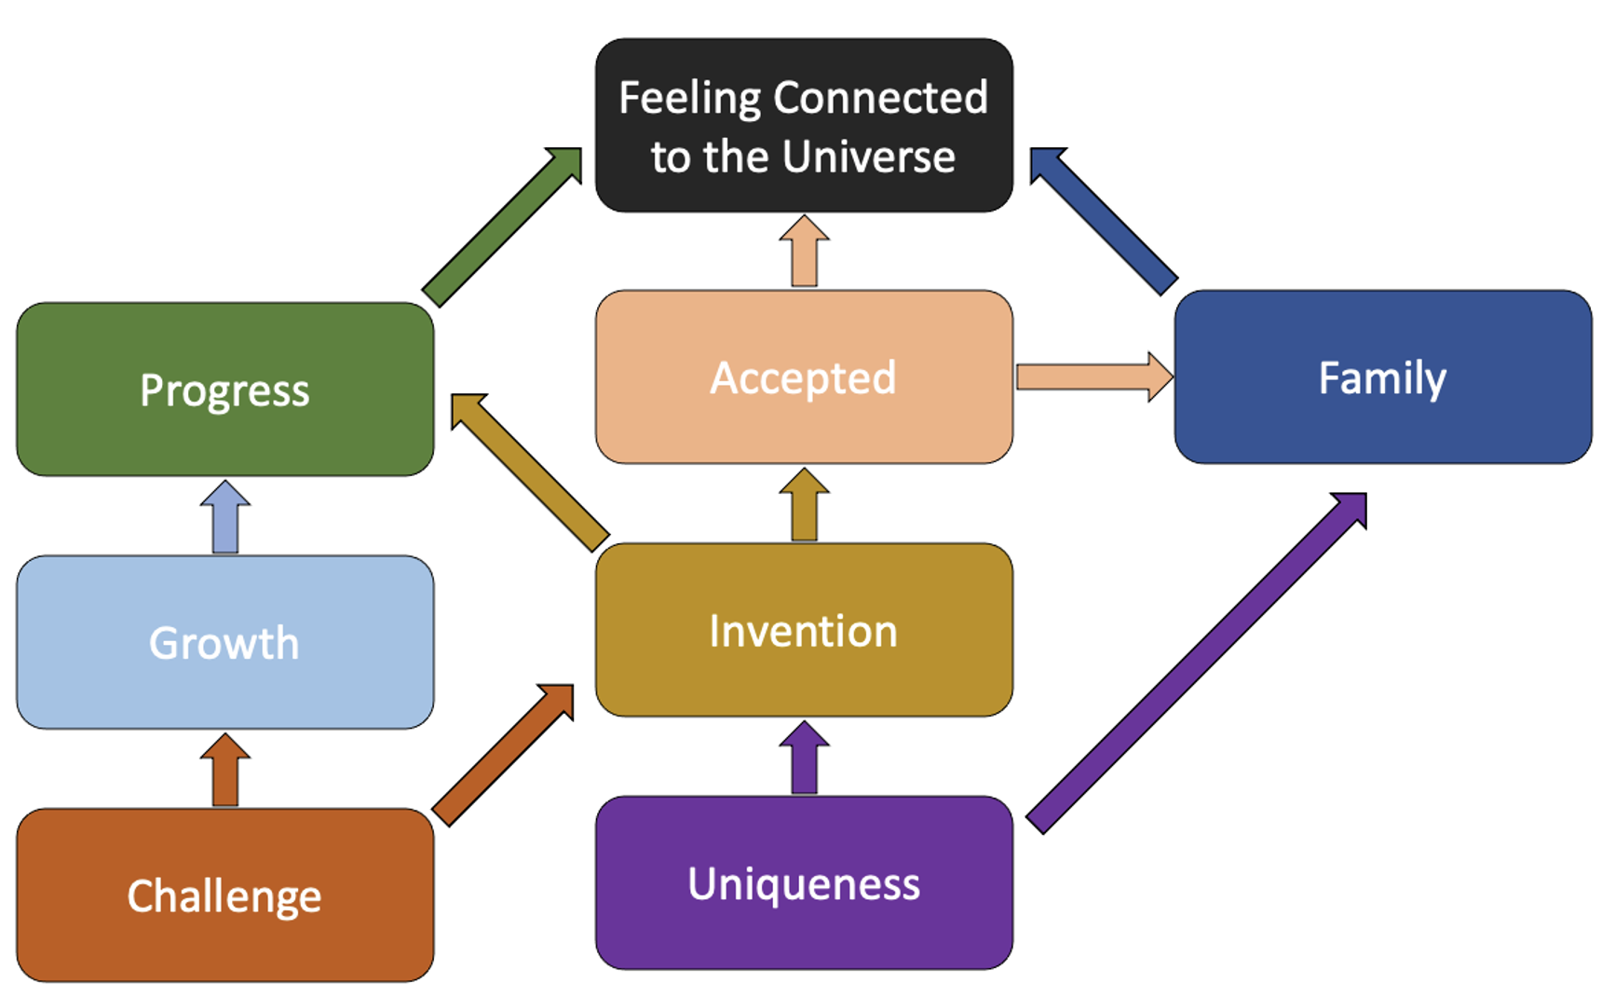
Neeraj Asthana

Slide 7
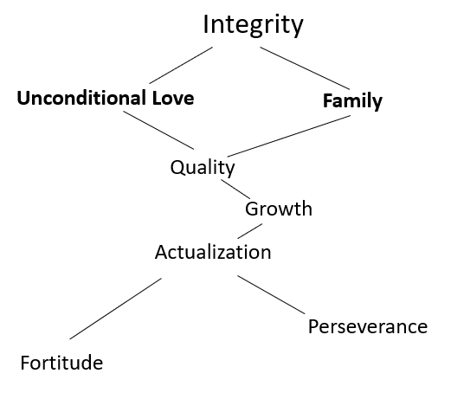
David Ayo

Slide 9
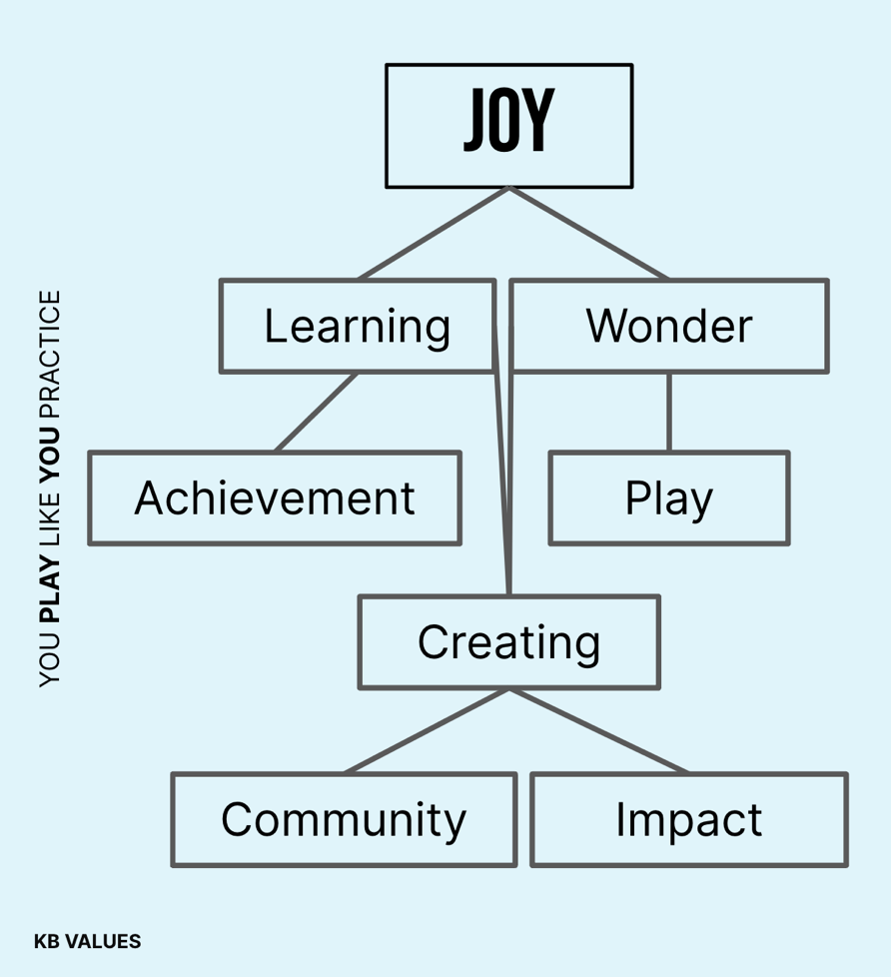
Kaitlyn Barclay

Slide 11
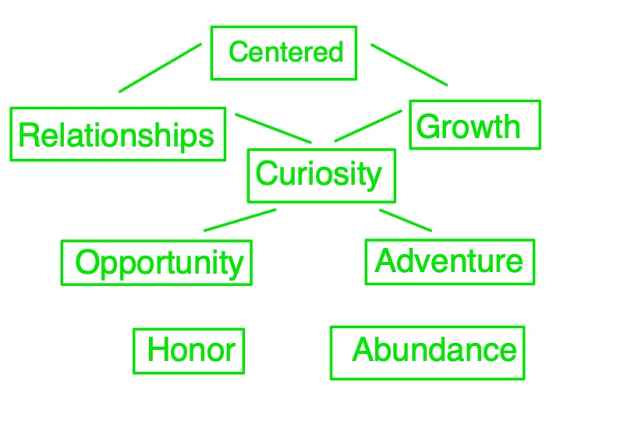
Chris Batz

Slide 13
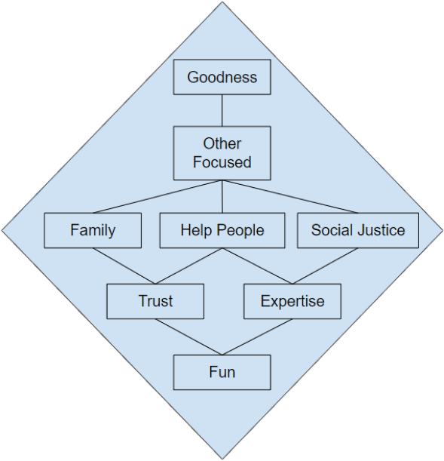
David Alexander Bautista

Slide 15
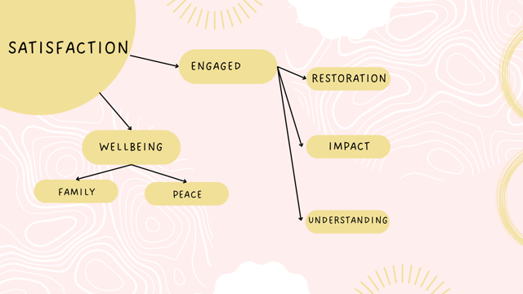
Michelle Mondesir

Slide 17
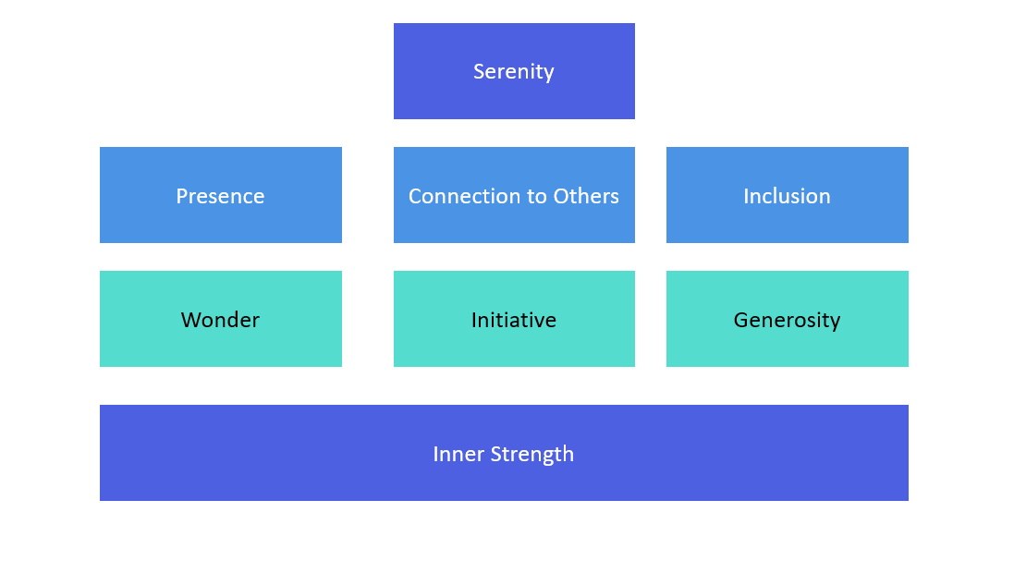
Gaea Bhalla

Slide 19
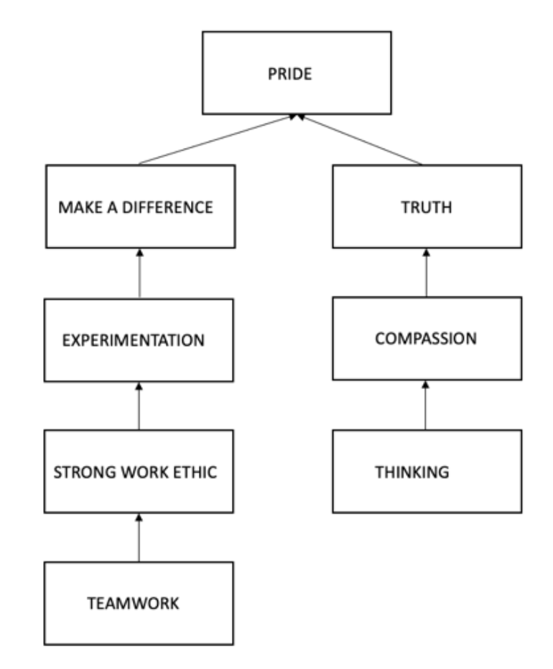
Mittal Bhiogade

Slide 21
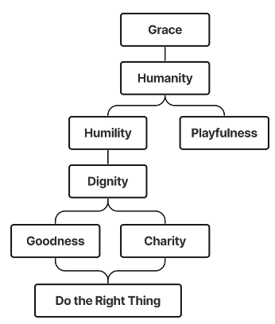
Benjamin Blad

Slide 23
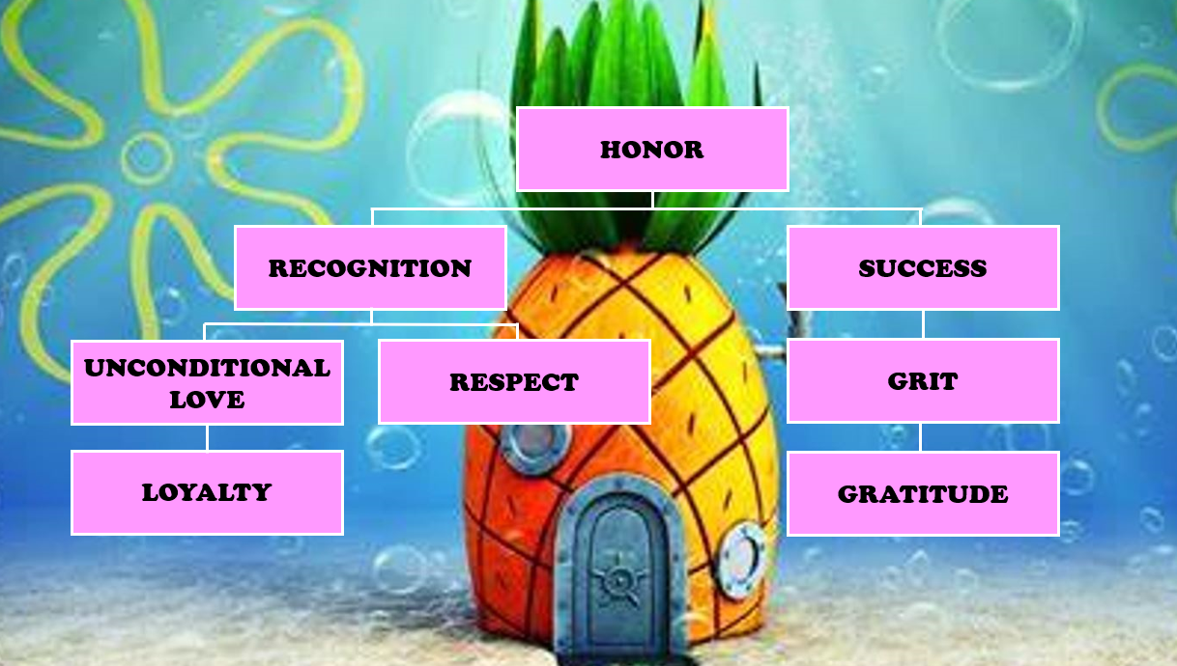
Athena Boncan

Slide 25
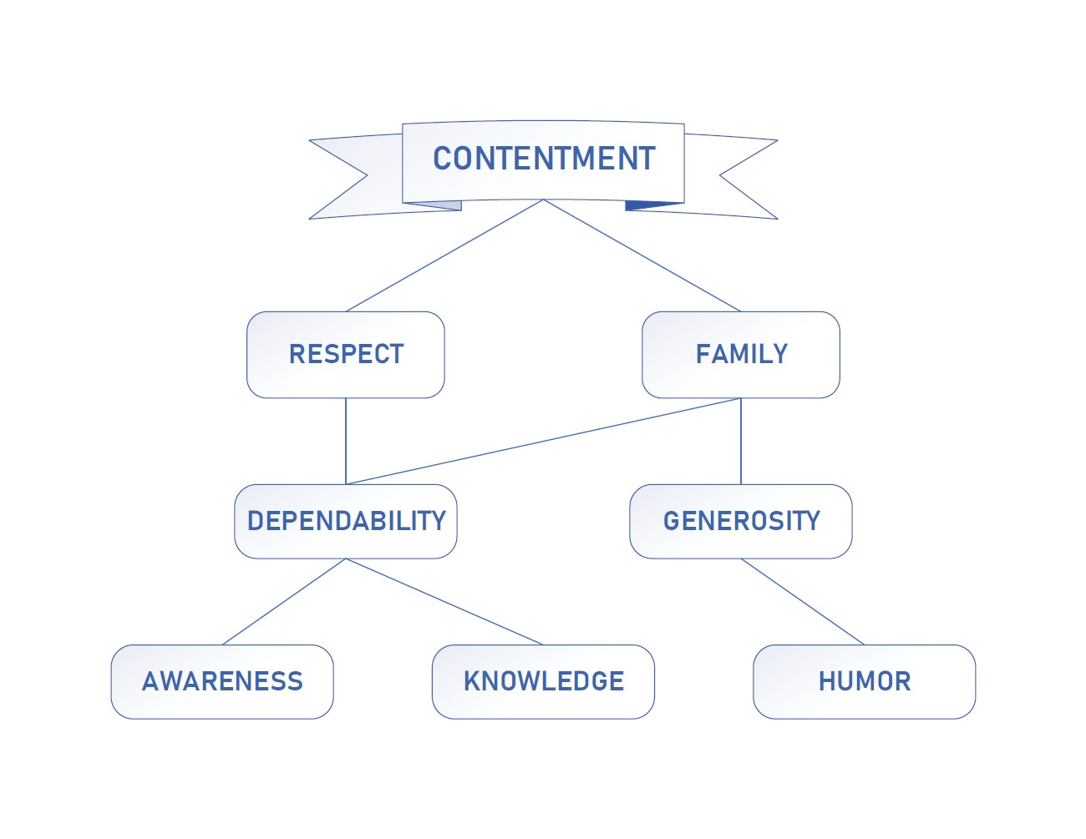
Jared Bower

Slide 27

Kathreen-Marie Capiral

Slide 29
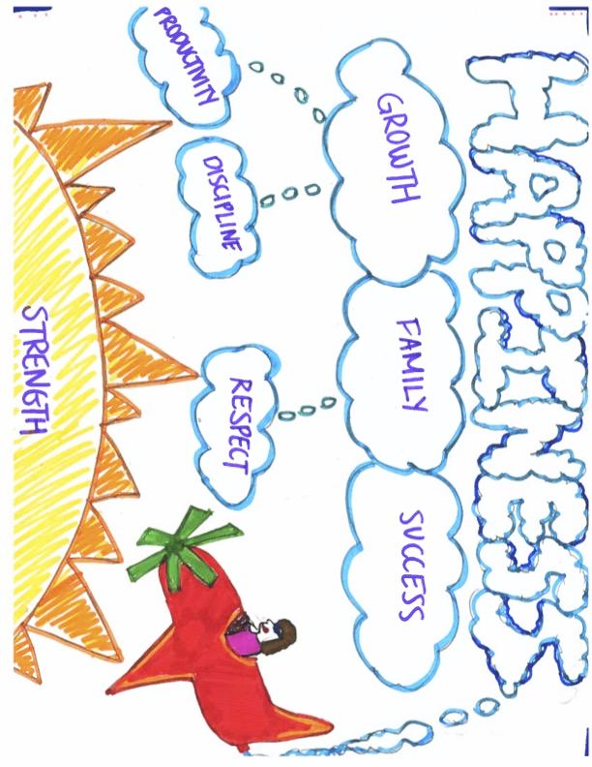
Jothika Cholan

Slide 31
Ace Cook
wealth
greatness
success
harmony
equanimity
fortitude
Critical thinking

Slide 33
Chris Dinan

Slide 35
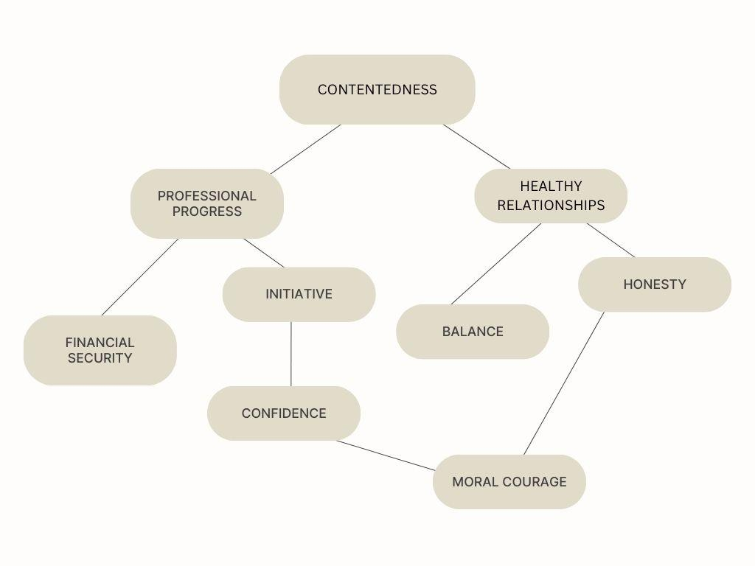
Brady Donnelly

Slide 37
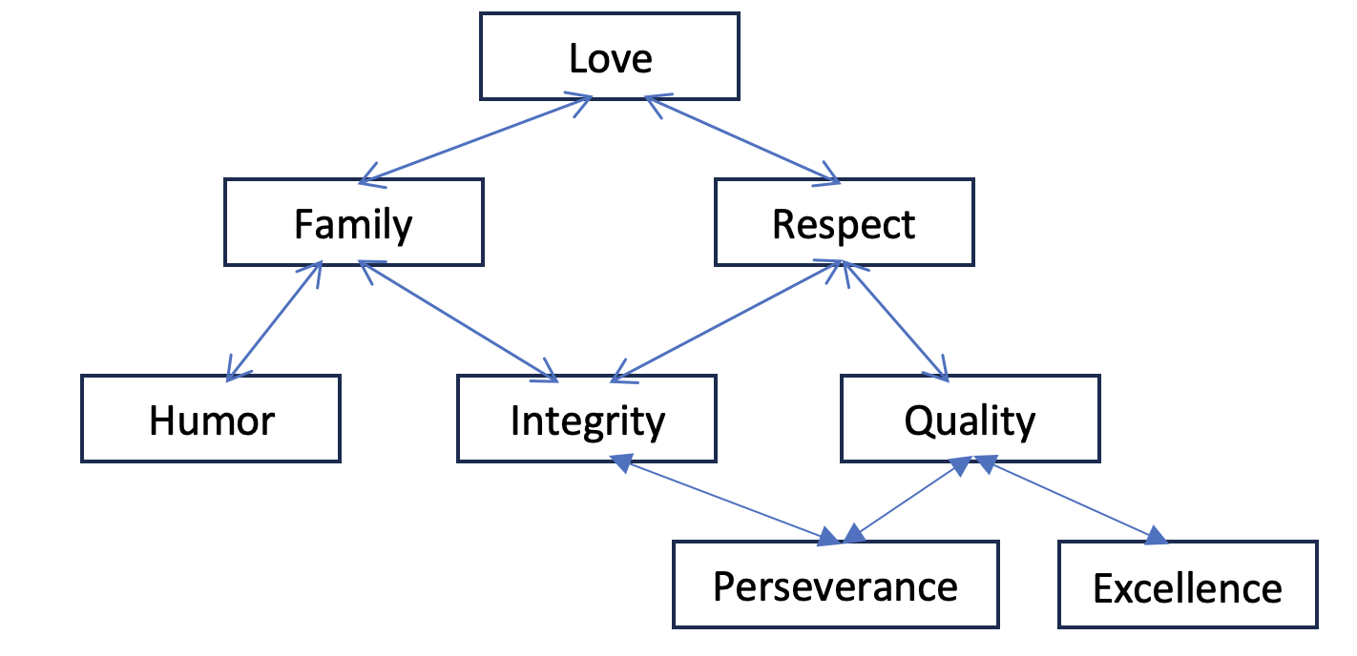
Omar Elmasry

Slide 39
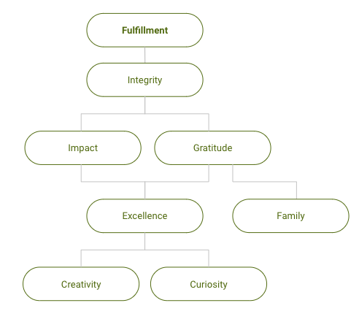
McKenna Elves

Slide 41
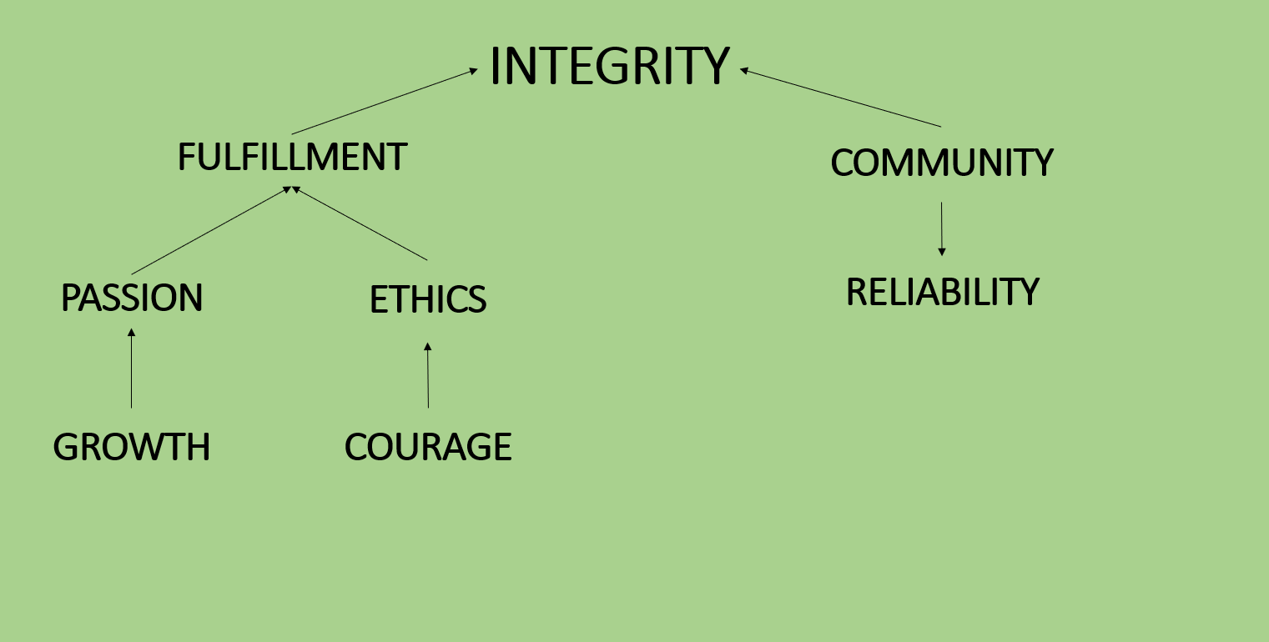
Ross Fayne

Slide 43
Tomasz Felpel
success
accomplishment
commitment
organization
opportunity
Job effectiveness
strong work ethic
positivity

Slide 45
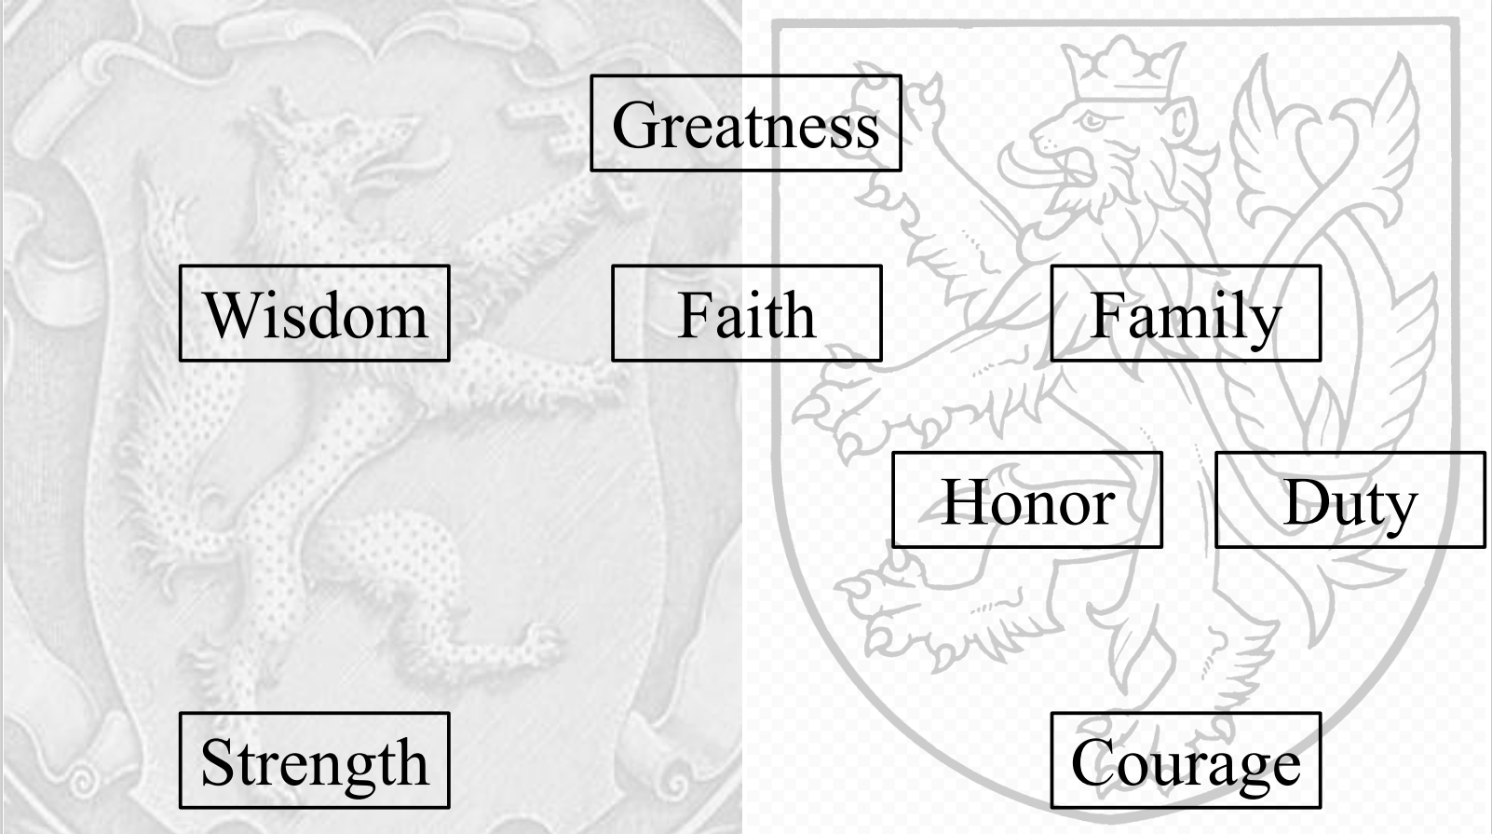
Nick Gajdzik

Slide 47
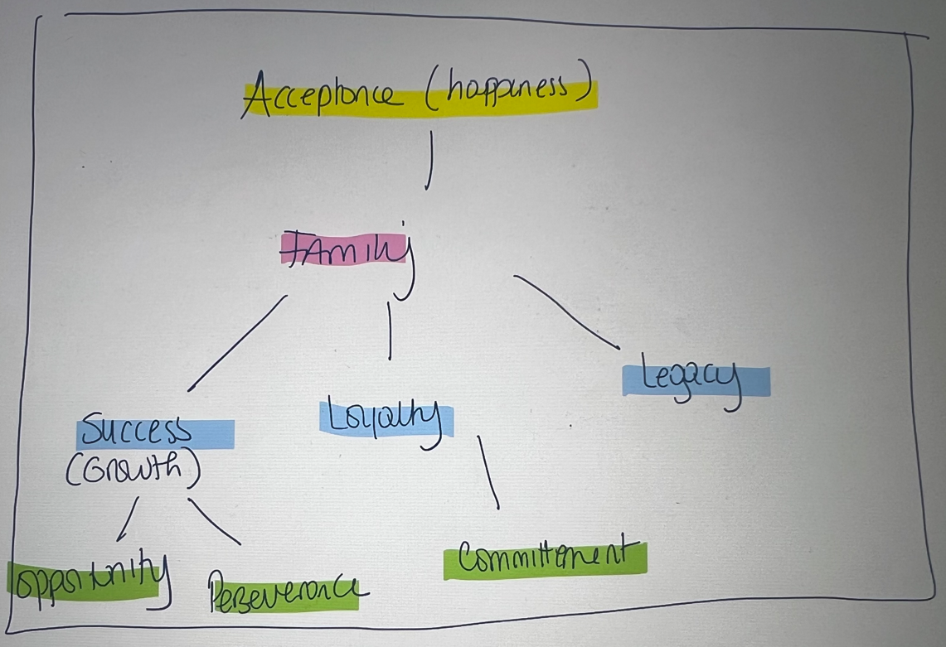
Tatiana Gholmie

Slide 49
Isabelle Giap
happiness
Friends & family
excellence
fun
empathy
grace
authenticity
strength

Slide 51
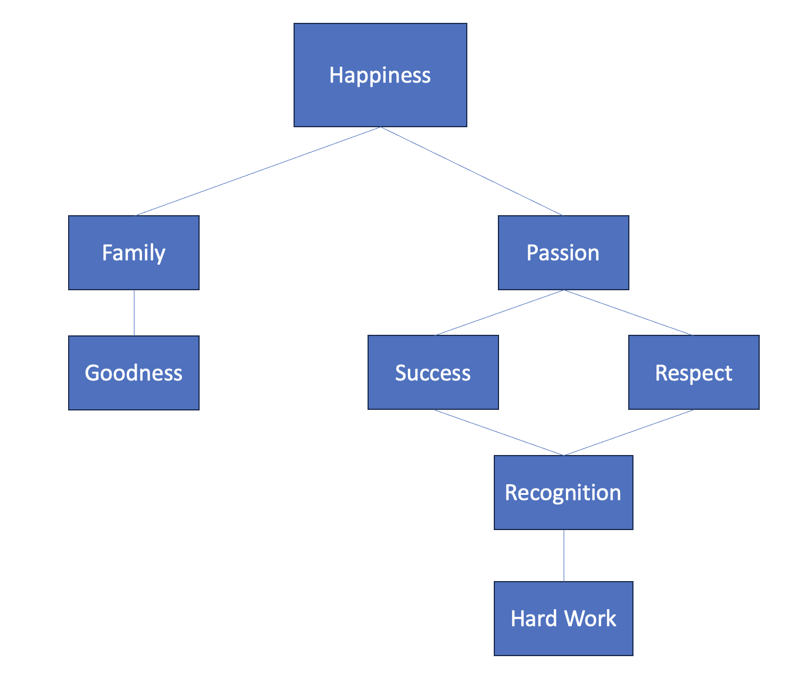
Aneisha Gill

Slide 53
Barbara Gomes da Silva
happiness
excellence
family
passion
loyalty
generosity
perseverance
curiosity

Slide 55
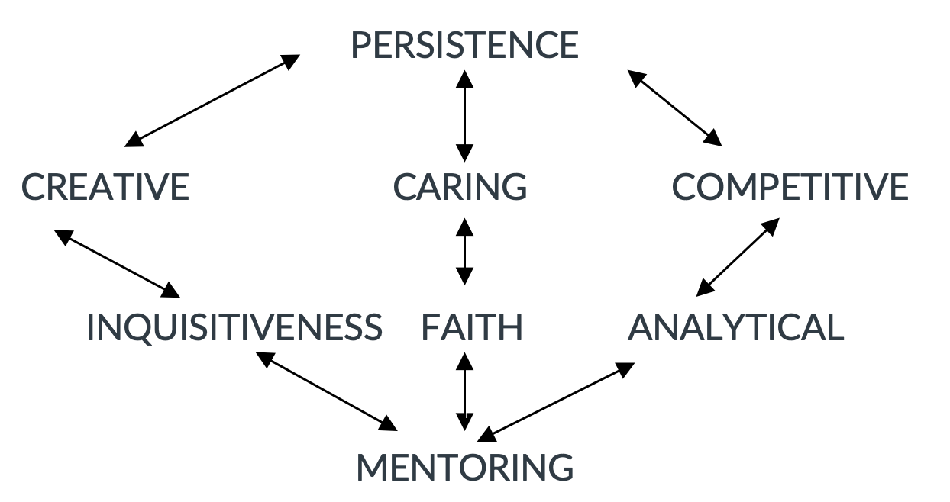
Joseph Gorum

Slide 57
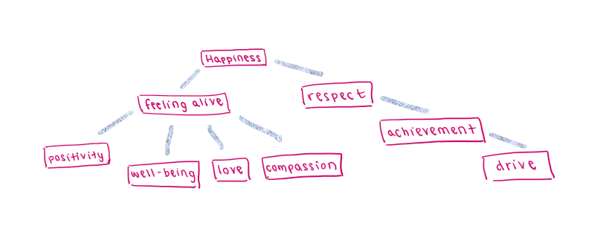
Sarah Higgins

Slide 59
Lawrence Ji
satisfaction
Feeling alive
achievement
enthusiasm
intellectualism
wealth
dedication
confidence

Slide 61
Sarah Kislak
growth
fulfillment
adventure
resilience
service
relationships
creativity
bravery

Slide 63
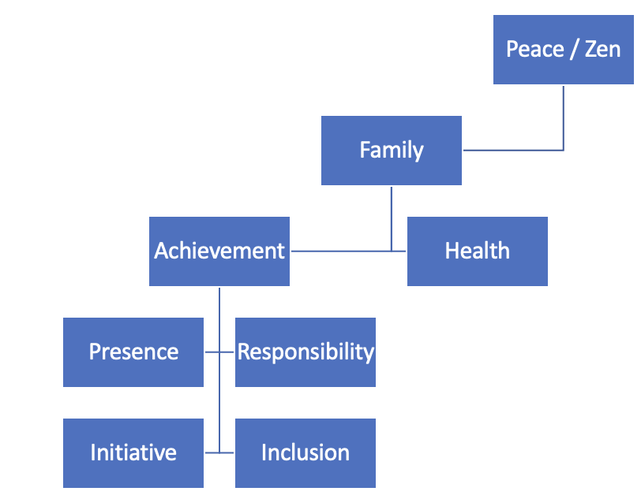
Sarah Andrews

Slide 65
Paul Kwak
joy
change
autonomy
contentment
imagination
diversity
service
awareness

Slide 67
MJ Lopez
peace
freedom
empowerment
dreaming
sense of humor
loyalty
Do the right thing
Self esteem

Slide 69
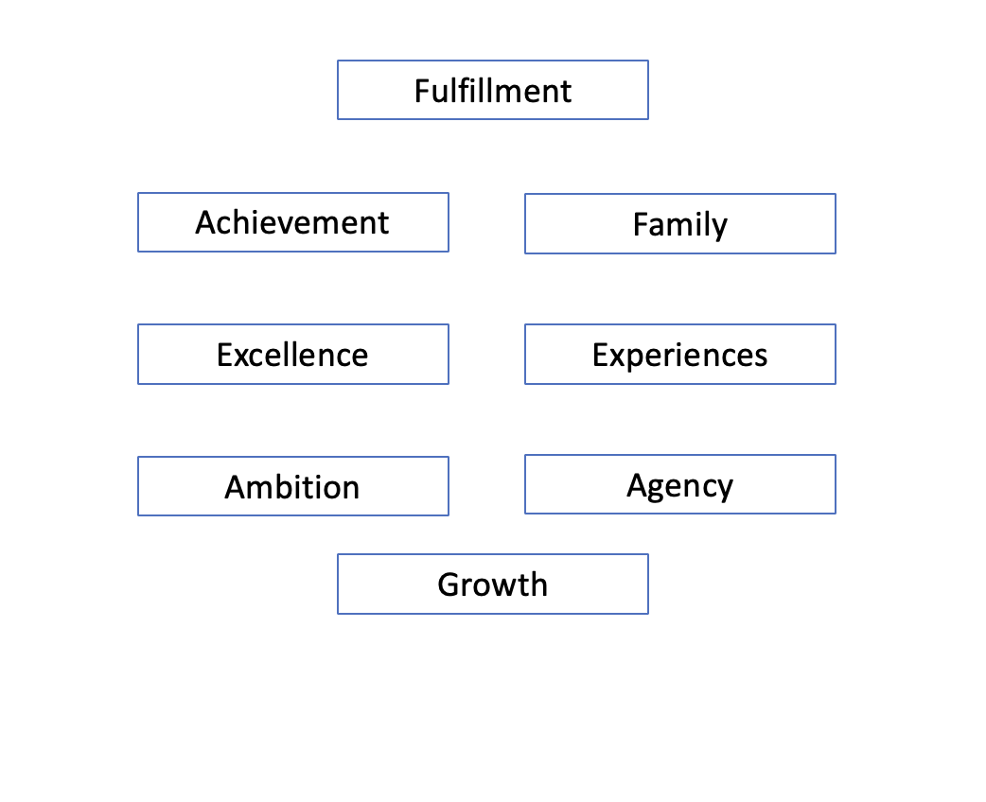
Bart Macdonald

Slide 71
Anupama Rupesh Malladi
harmony
Family & friends
Making an impact
Help people
dependability
progress
authenticity
fairness

Slide 73
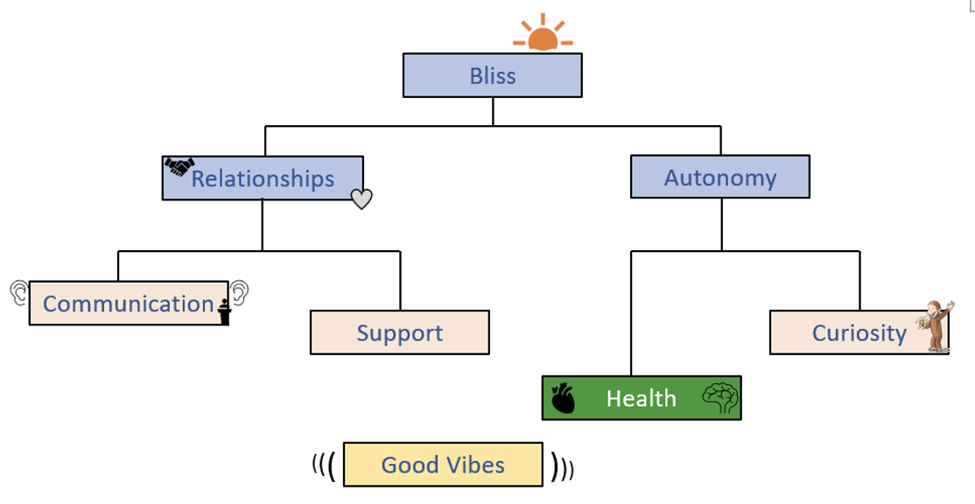
Jordan May

Slide 75
Ravi Mehta
satisfaction
balance
fulfillment
success
freedom
relationships
growth
commitment

Slide 77
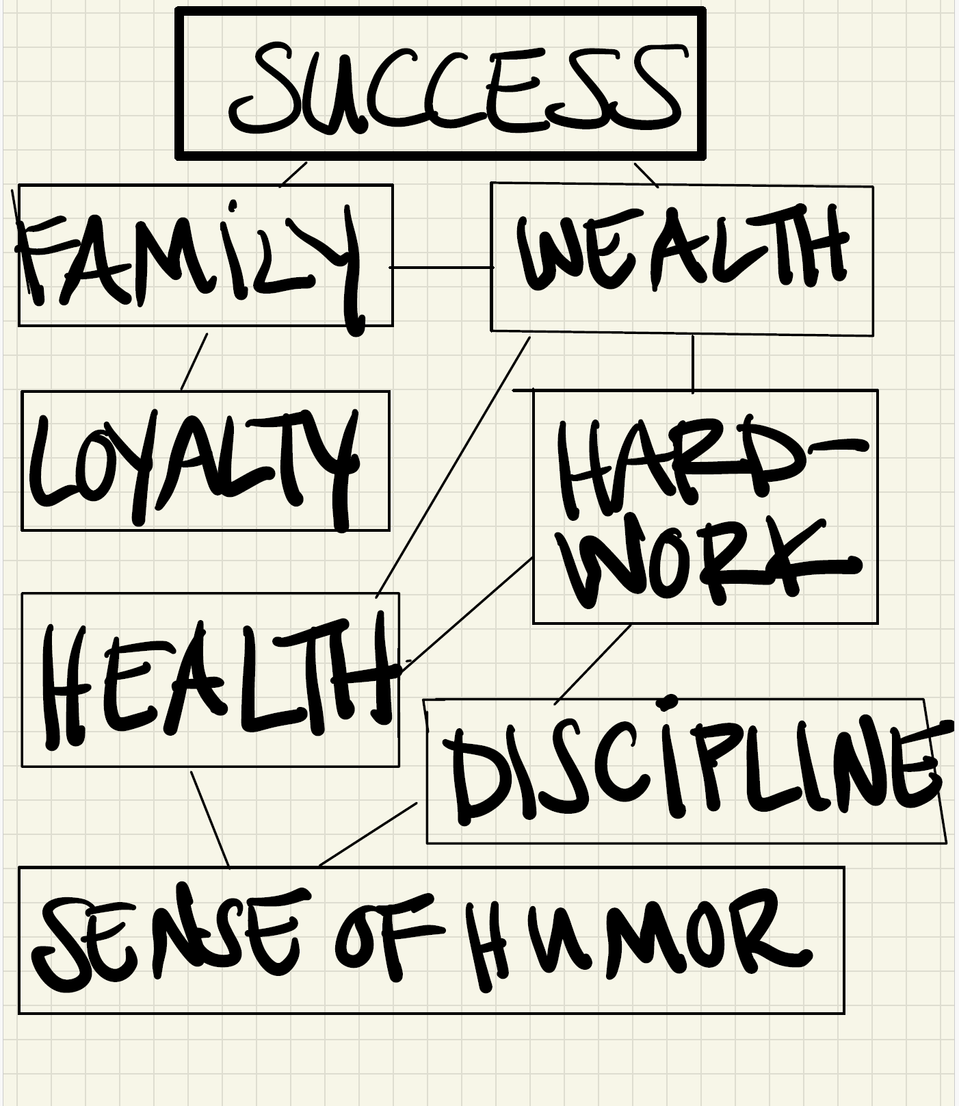
John Najarian

Slide 79
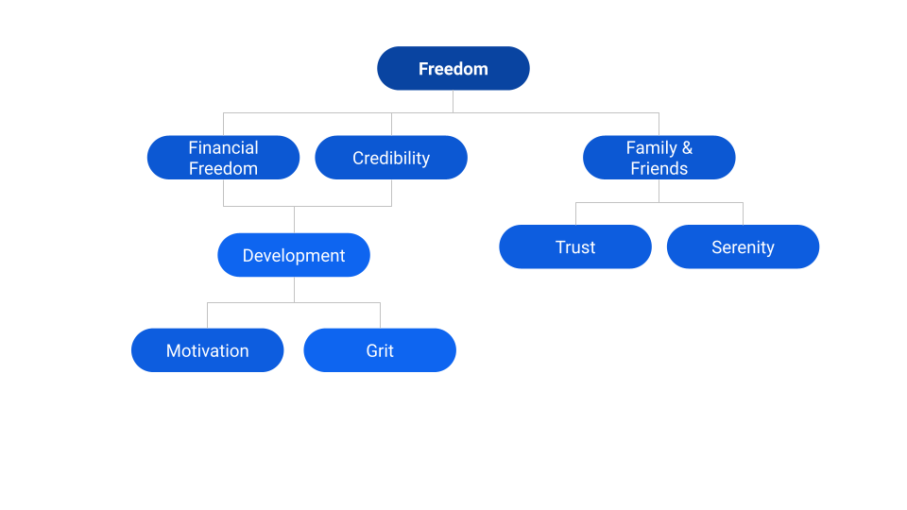
Bruno Neme Farha

Slide 81
Josh Neustadter
identity
Self esteem
honesty
loyalty
validation
health
Do the right thing
humor

Slide 83
Emmanuel Ogunkola
affirmation
Maximize income
intellectualism
admiration
patience
invention
active
spirituality

Slide 85
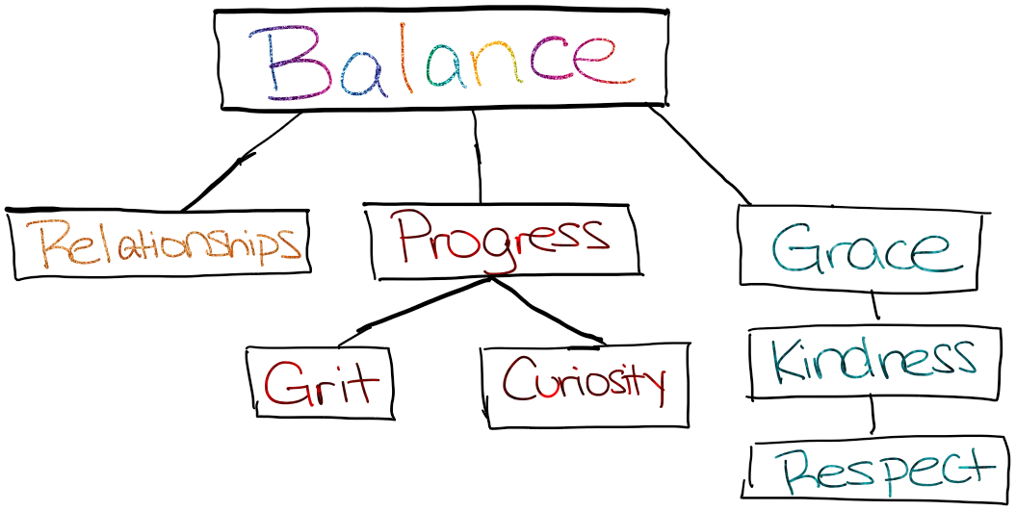
Shabeen Rehman

Slide 87
William Reich

Slide 89
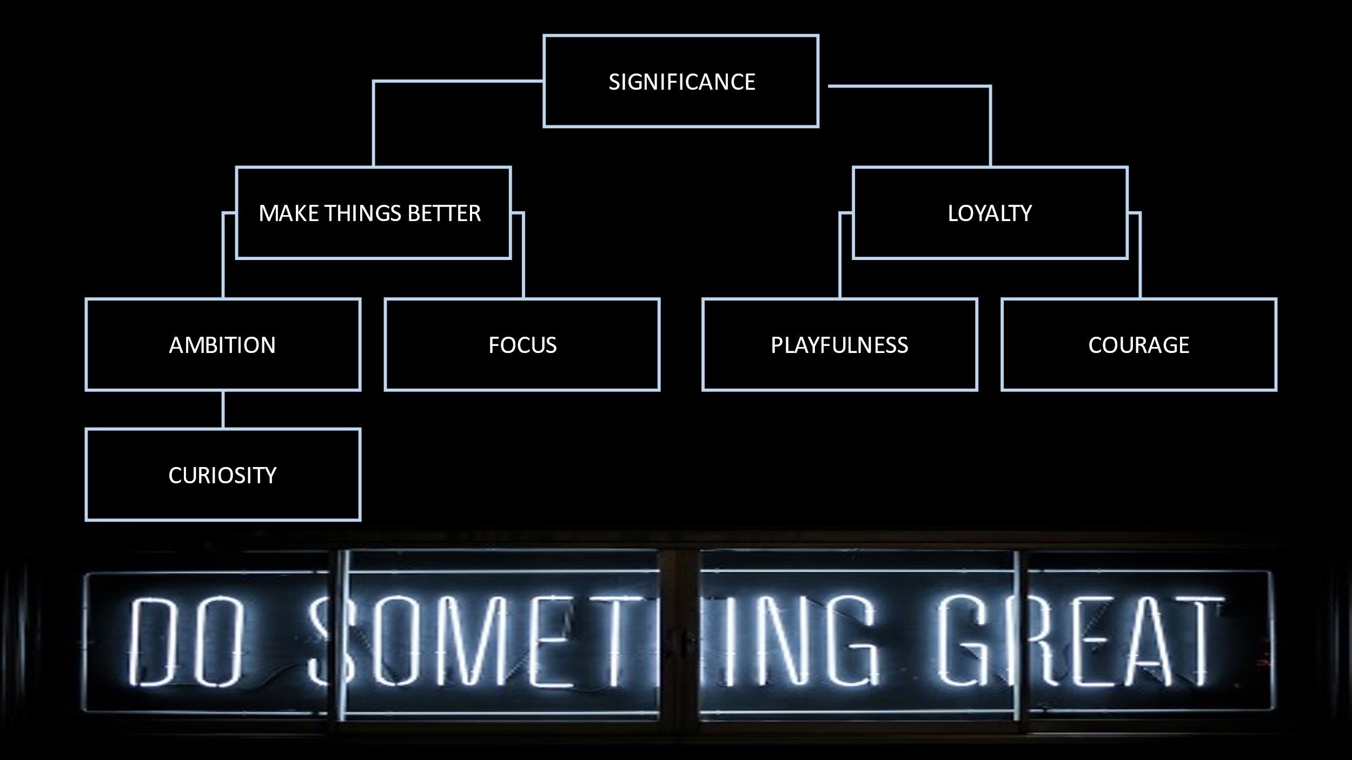
Michael Rodriguez

Slide 91
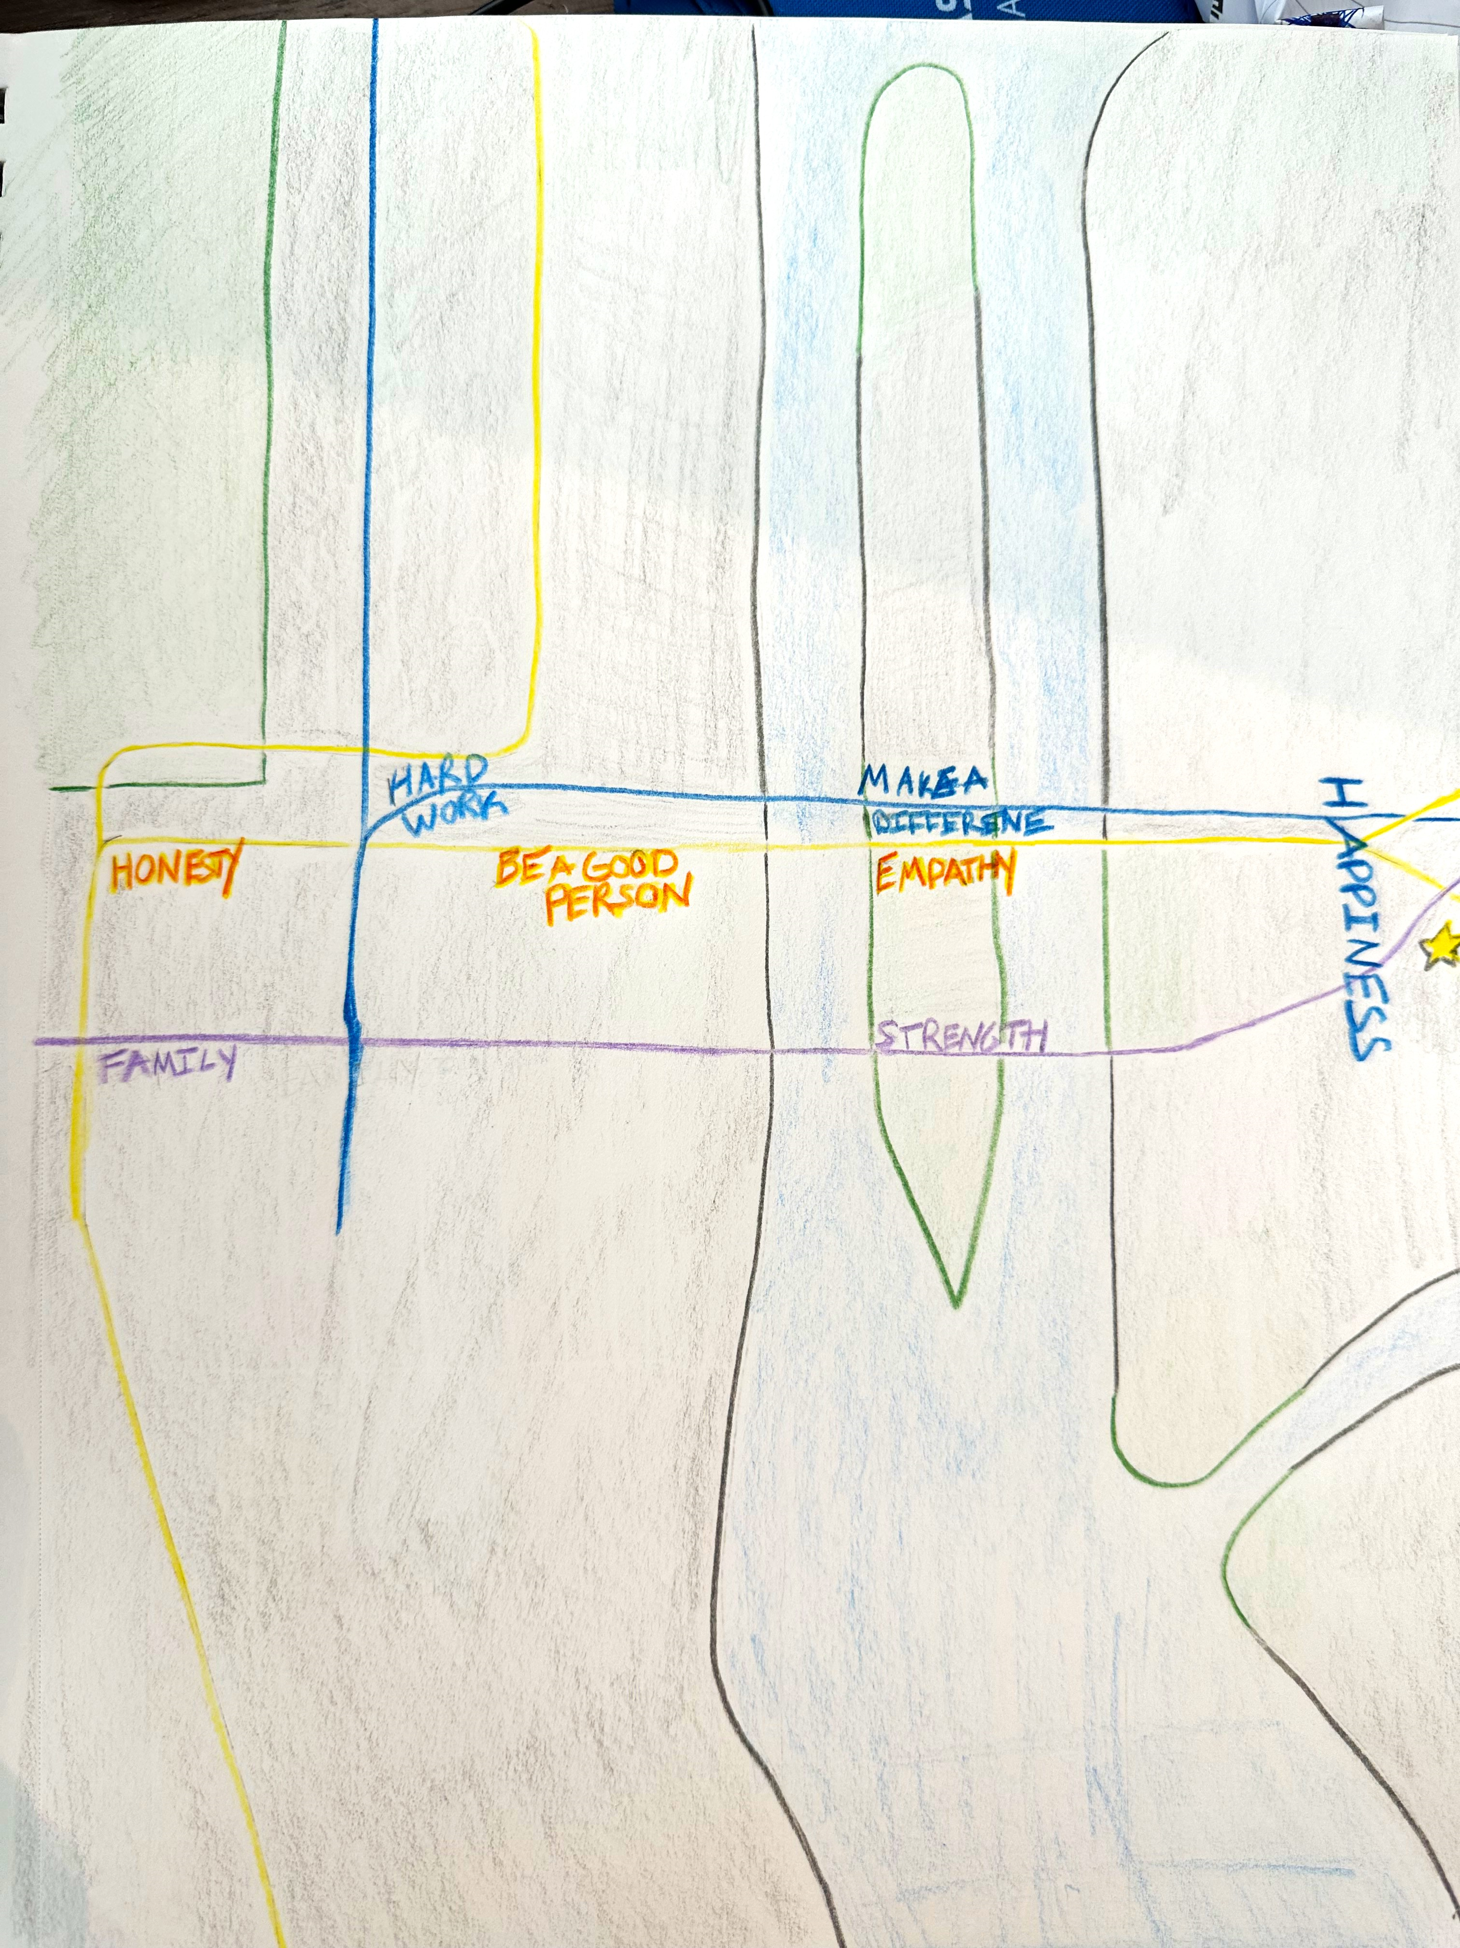
Allison Roye

Slide 93
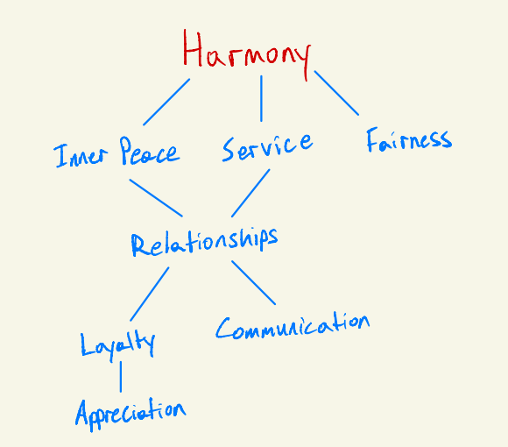
Avri Sainte

Slide 95
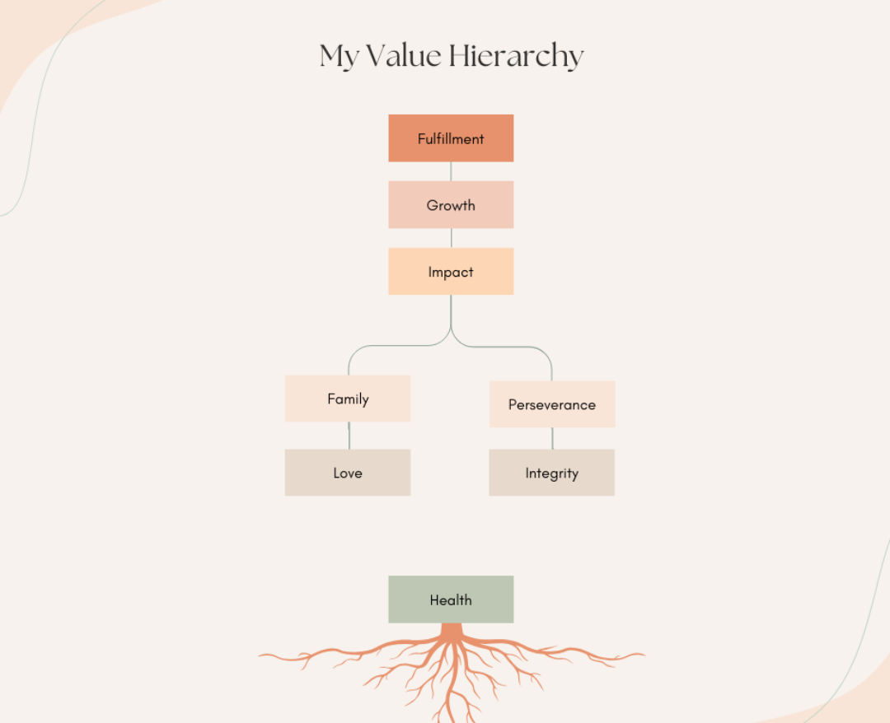
Natalie Shammas

Slide 97
Alexandra Silverman
fulfillment
family
gratitude
joy
Make things better
respect
passion
excellence

Slide 99
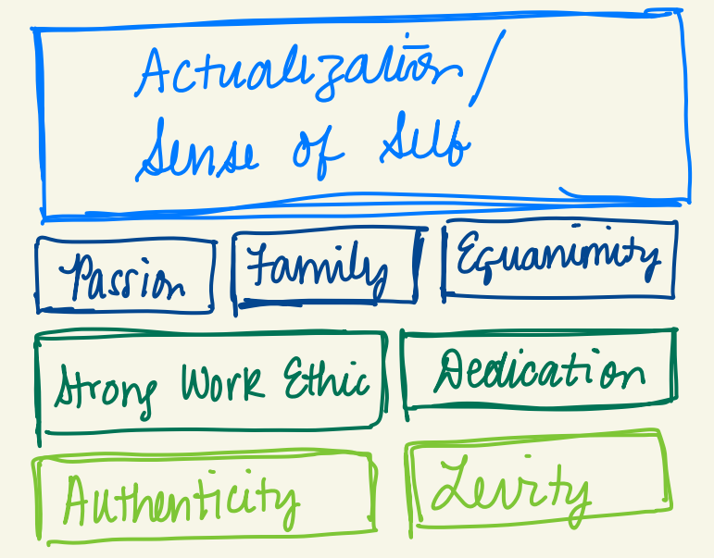
Adithya Simha

Slide 101
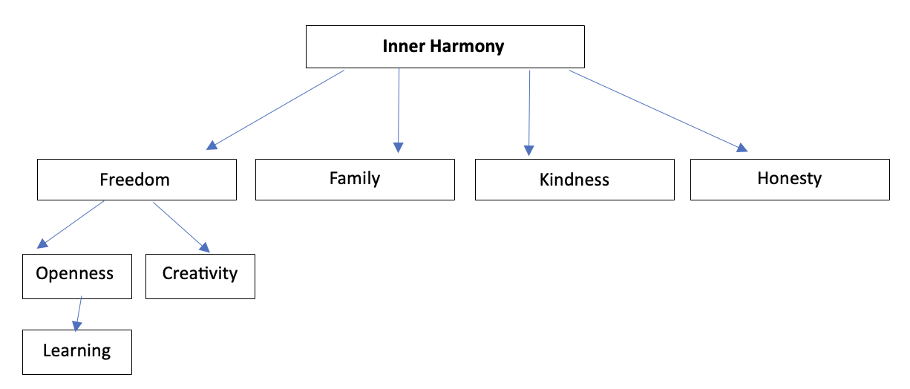
Cybill Su

Slide 103
Caleb Trees
faith
other-focused
hope
peace
family
service
steadfast
success

Slide 105
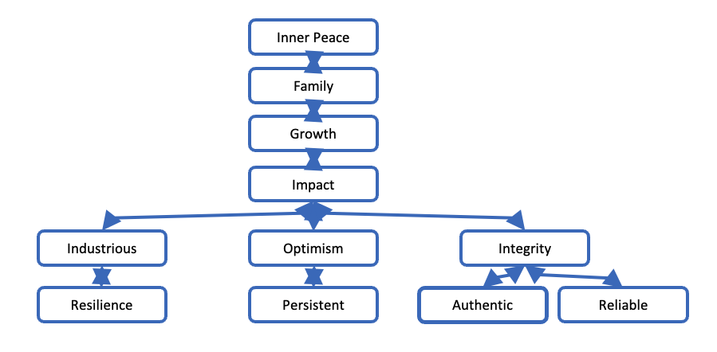
Anurag Varshney

Slide 107
Michael Vigliarolo
happiness
Golden rule
Family + friends
integrity
excellence
respect
trust
Make things better

Slide 109
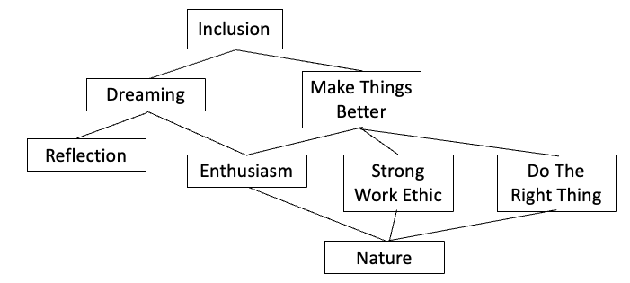
Evan Waggoner

Slide 111
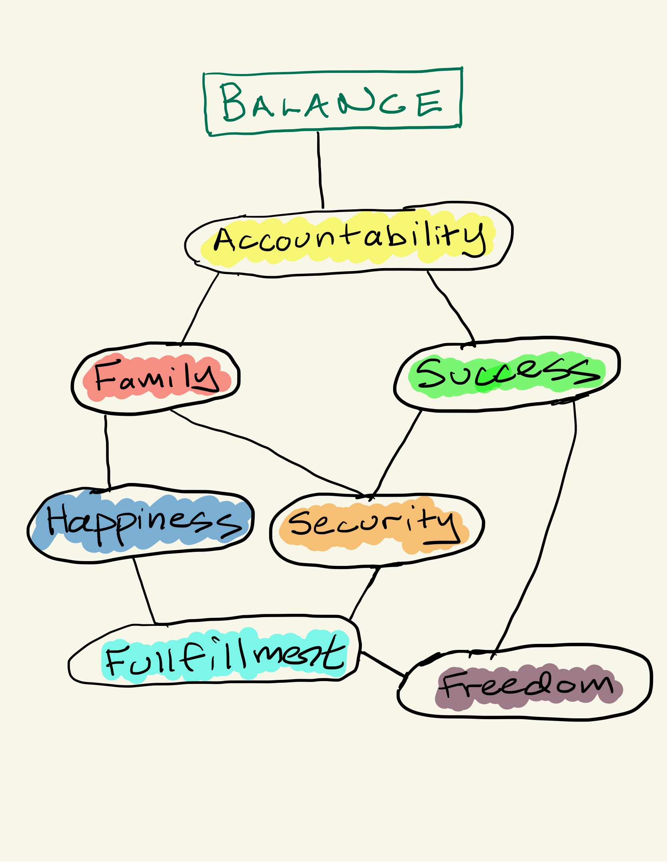
Philip Yim

Slide 113
Moe Yousuf
integrity
family
Financial security
mentoring
change
curiosity
rigor
transparency

Slide 115
Richie Zhang
Fulfilment
Family
Achievement
Respect
Connection
Make an Impact
Excellence
Integrity
Kindness
Reliability

